Slide 1
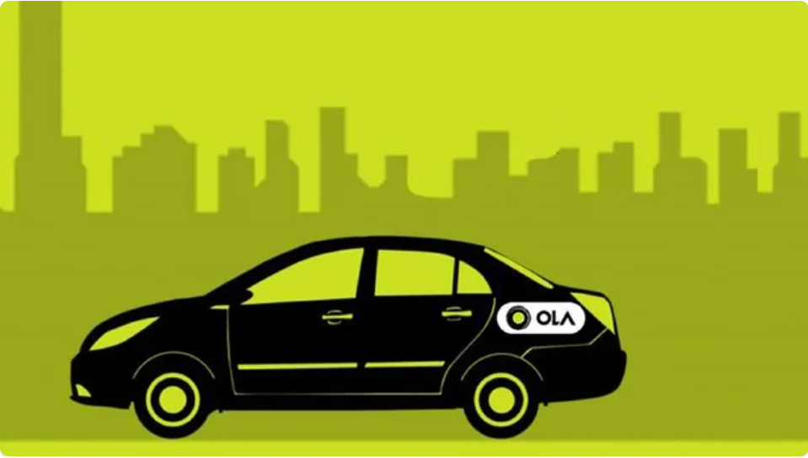
🚖 OLA Bookings for the month July-2024

Slide 2
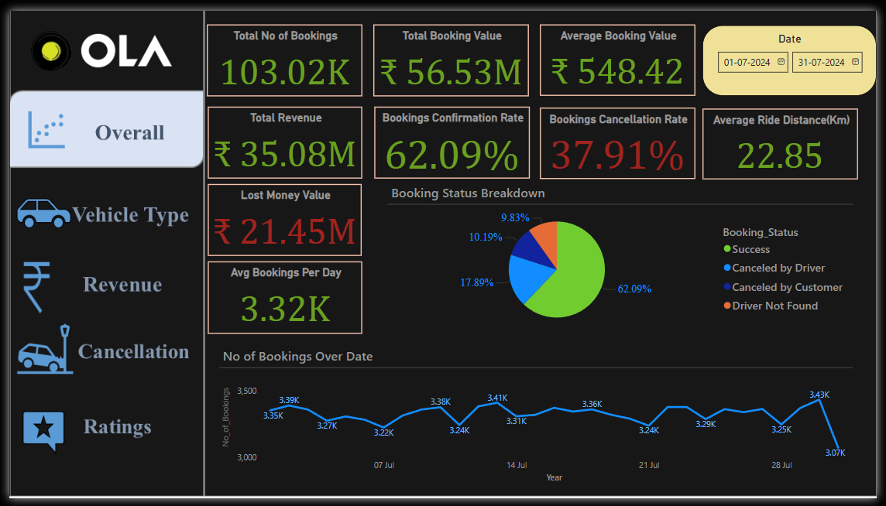
🚖 Analysis of OLA Bookings for July 2024

Slide 3
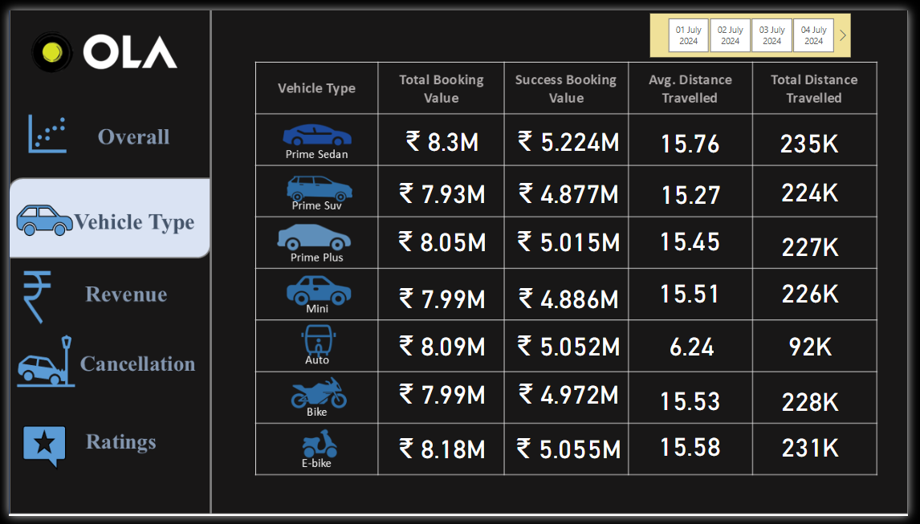
🚖 Analysis of OLA Bookings for July 2024

Slide 4
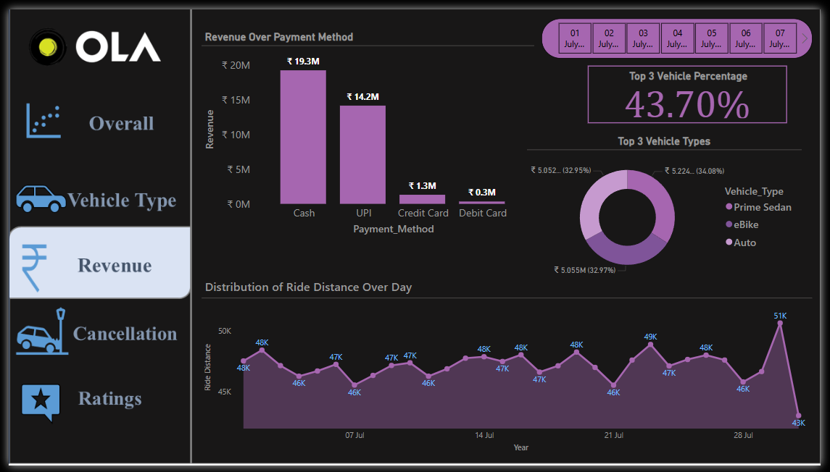
🚖 Analysis of OLA Bookings for July 2024

Slide 5
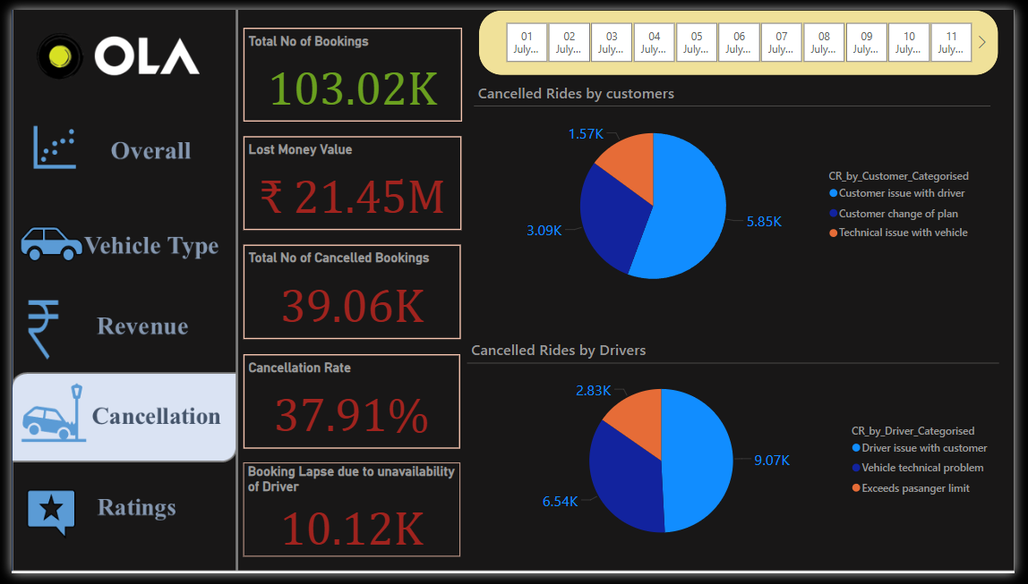
🚖 Analysis of OLA Bookings for July 2024

Slide 6
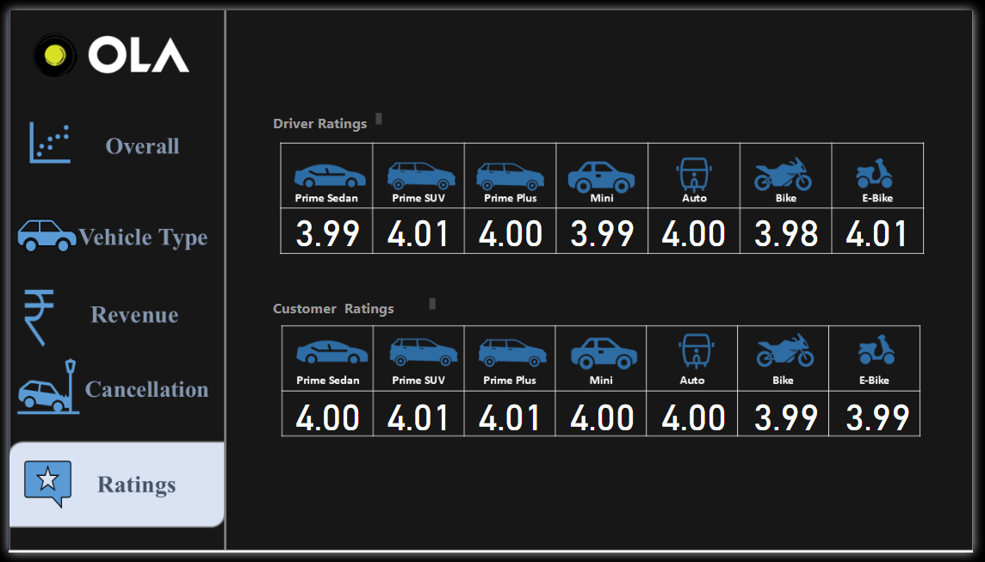
🚖 Analysis of OLA Bookings for July 2024

Slide 7
🚖 Analysis of OLA Bookings for July 2024
Purpose:
This analysis aims to optimize revenue, reduce cancellations, and enhance customer experience for OLA in July 2024.”
Process:
Cleaned and processed data from multiple sources, primarily using "Excel" for data cleaning.
Applied "SQL queries" for data manipulation and visualized trends using "Power BI".
📊 Key Highlights:
Achieved a revenue of ₹35.8M with a 62.09% booking confirmation rate.
Faced a 37.91% cancellation rate, resulting in a ₹21.45M loss of money value.
Peaked booking on July 30 (3.43K) as a highest bookings in a day in July and July 31st(3.07K) provided the lowest bookings of July month
with an average of 3.32K bookings per day.
The daily bookings deviate by Standard Deviation 69.19 from the mean of 3323.35 suggesting that the bookings are fairly consistent on a daily basis with moderate variation
around the average.
Prime Sedan, E-bike, and Auto generated 43.70% of total revenue, indicating key areas for targeted marketing.
Cash remains the top transaction method (₹19.3M), followed by UPI (₹14.2M).
❌ Cancellation Analysis:
Out of 103.02K bookings, 39.06K were cancelled.
Driver Unavailability: 10.12K cancellations.
Driver Cancellations: 18.44K cancellations.
Customer Cancellations: 10.51K cancellations.
🔍 Top Reasons for Cancellations:
Conflict between Driver and Customer: 14.92K cancellations.
Vehicle Technical Issues: 9.63K cancellations.
Customer Change of Plans: 3.09K cancellations.
Passenger Limit Exceeded: 2.83K cancellations.

Slide 8
🚖 Analysis of OLA Bookings for July 2024
💡 Actionable Insights:
Optimise Revenue: Top 3 Vehicles such as Prime Sedan, E-bike, and Auto owns 43.70% of Total revenue thus targeted locations with these vehicles can further enhance their revenue share.
Operational Efficiency: Encourage digital payments to reduce cash handling cost.
Reducing Cancellations and enhance customer experience:
Driver Management: Incentivize drivers, long term partner ships with drivers and enhance driver-customer matching algorithms over region.
Customer & Driver Issues: Provide training on code of conduct on duty, steps to follow in case of disagreements with customer make a riding process system driven to the extent possible (Eg: If customer needs an AC, then customer have to enable that option while booking a ride).
Offer rewards, Discounts to users who have maintained their travel streak with ola on a daily basis for x no of days.
Maintenance: Implement regular vehicle checks to avoid technical issues.
To turnout booking cancellations positive: Improve booking information and refund policies such as turning booking value to vouchers incase of cancellation of booking after 5 mins of Booking by customer.
With these insights, I aim to contribute to data-driven decisions that drive business success, enhance operational efficiency, and improve customer satisfaction.
If you are in the Last slide of the Presentation
Comment your views on analysis
Darshan.Rajeev.Naik
Email:naikdarshan221@gmail.com
Thank You!!

